Slide 1


Learn to troubleshoot your code
Alfredo Salazar Vélez

Slide 2
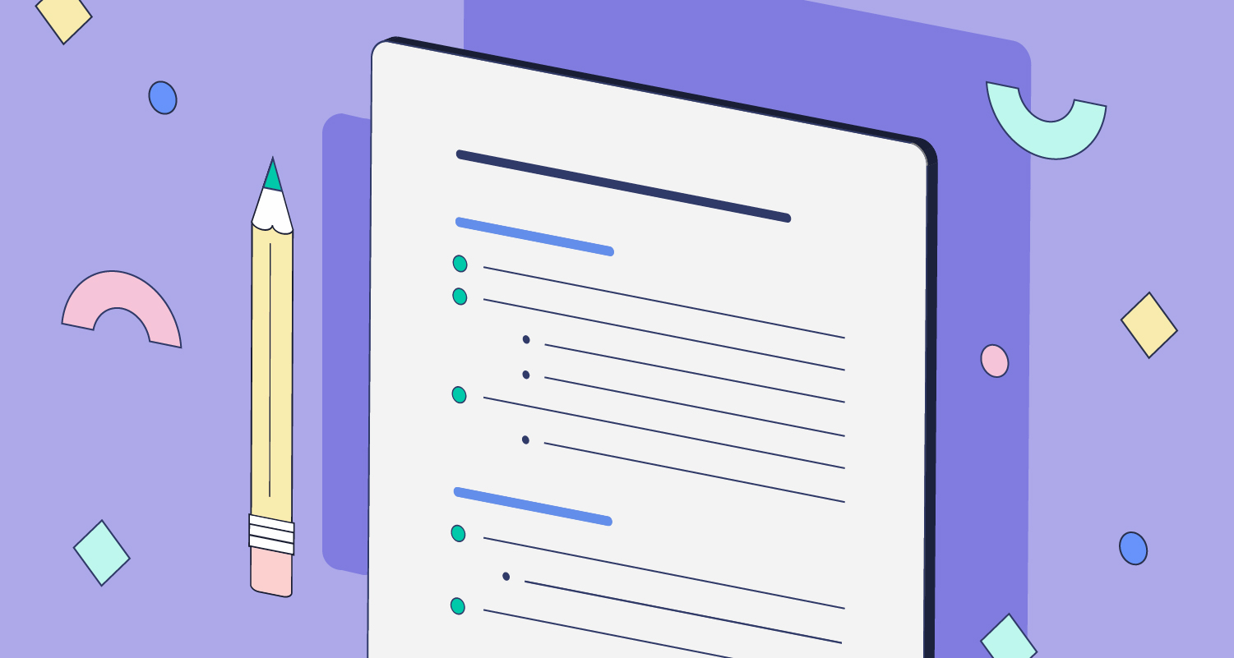
What are we covering today:
The importance of testing and debugging.
Showcase of snippets of code containing errors.
Learning to read through error messages and look for them at documentation.
Short Q&A after each snippet has been solved.

Slide 3

Open questions

